Slide 1
Agent-Based Document Q&A System with MCP Integration
Presented By:
B.Sahith
Notes:
Image source: http://anjumancoe.blogspot.com/2016/08/gi-fi-technology-of-new-era-by-akansha.html

Slide 2
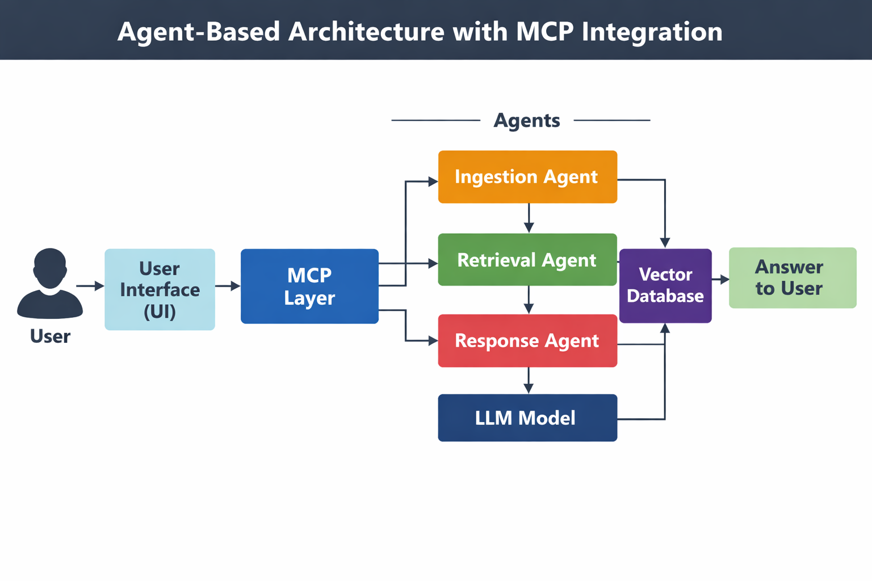
AGENT-BASED ARCHITECTURE (WITH MCP)

Slide 3
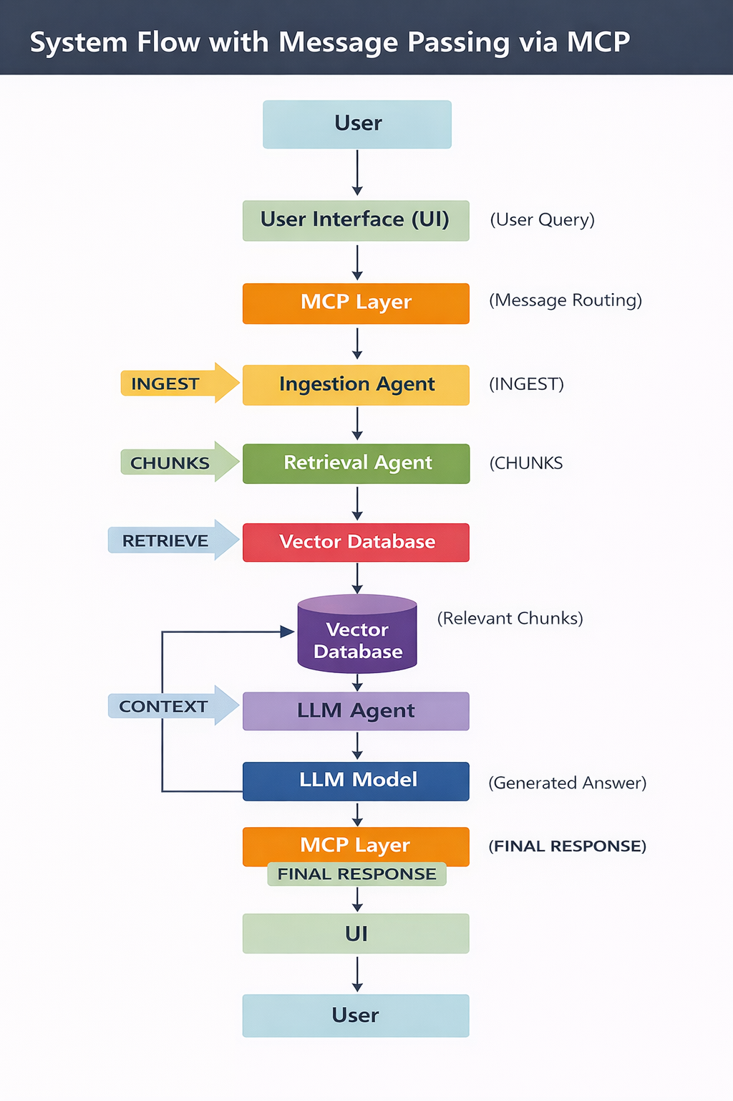
SYSTEM FLOW DIAGRAM (WITH MESSAGE PASSING)

Slide 4
TECH STACK
Frontend: Streamlit
Backend: Python
LLM: Groq (LLaMA / Mixtral)
Embeddings: HuggingFace
Vector DB: FAISS
Libraries: LangChain, PyPDF2, pandas

Slide 5
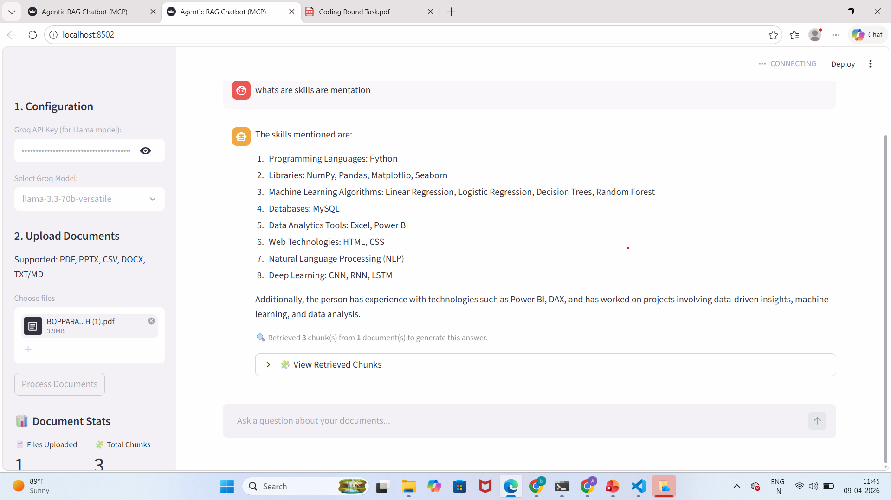
UI SCREENSHOT

Slide 6
Challenges Faced:
• Handling multiple file formats
• Managing chunk quality
• LLM response latency

Slide 7
Future Improvements:
• Add OpenAI / local models
• Persistent database
• Better UI/UX

Slide 8
Thank you

